Slide 1
Probabilistic Models for Classification

Slide 2
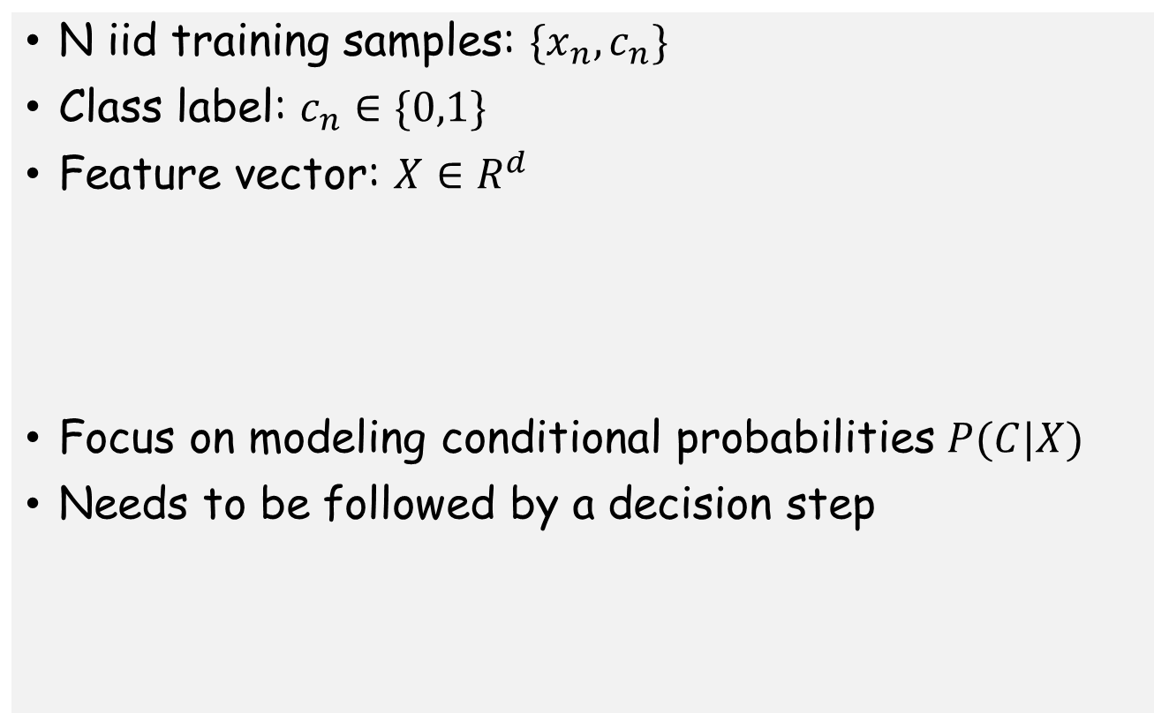
Binary Classification Problem
N iid training samples: $\{x_{n}, c_{n}\}$
Class label: $c_{n}∈\{0,1\}$
Feature vector: $X∈R^{d}$
Focus on modeling conditional probabilities $P(C|X)$
Needs to be followed by a decision step

Slide 3
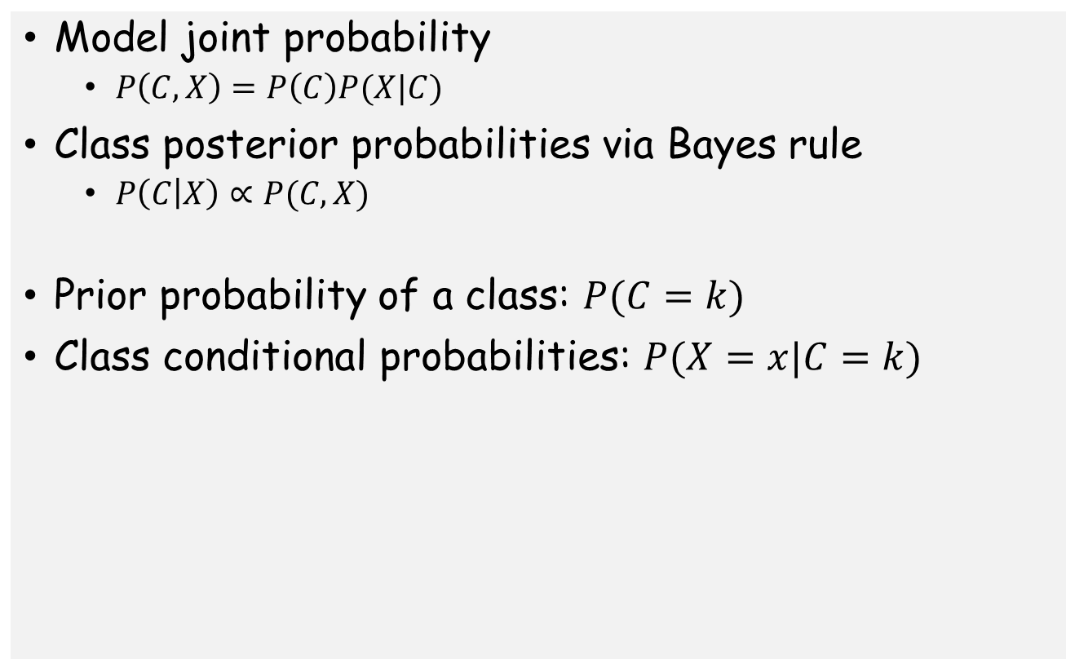
Generative models for classification
Model joint probability
$P\left(C,X\right)=P\left(C\right)P(X|C)$
Class posterior probabilities via Bayes rule
$P\left(C | X\right)∝P(C,X)$
Prior probability of a class: $P(C=k)$
Class conditional probabilities: $P(X=x|C=k)$

Slide 4
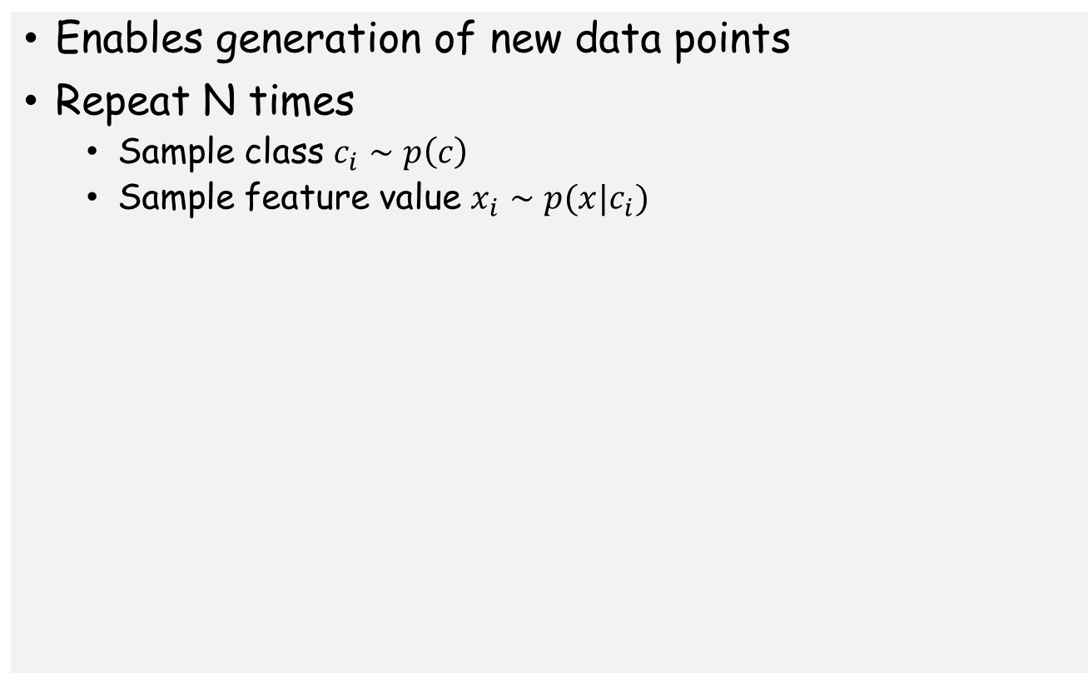
Generative Process for Data
Enables generation of new data points
Repeat N times
Sample class $c_{i}∼p\left(c\right)$
Sample feature value $x_{i}∼p(x|c_{i})$

Slide 5
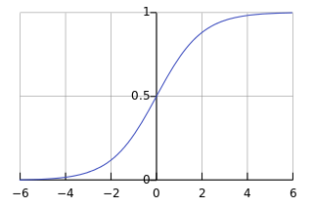
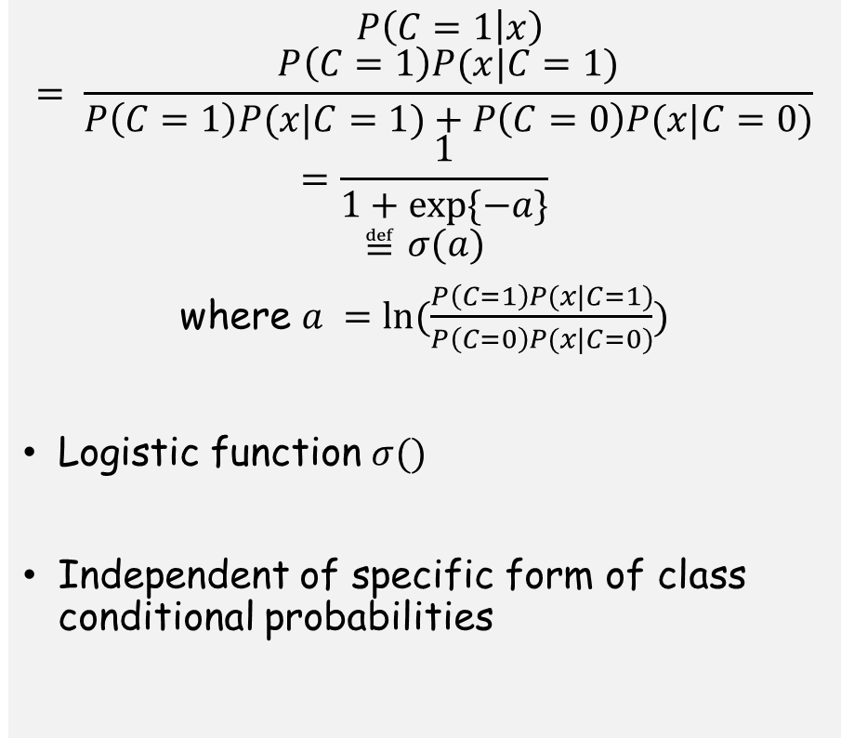
Conditional Probability in a Generative Model
$$P\left(C=1 | x\right)$$
$$= \frac{P\left(C=1\right)P(x|C=1)}{P\left(C=1\right)P(x|C=1)+P\left(C=0\right)P(x|C=0)}$$
$$=\frac{1}{1+exp⁡\{−a\}}$$
$$≝σ(a)$$
where $a =ln⁡(\frac{P\left(C=1\right)P(x|C=1)}{P\left(C=0\right)P(x|C=0)})$
Logistic function $σ()$
Independent of specific form of class conditional probabilities

Slide 6
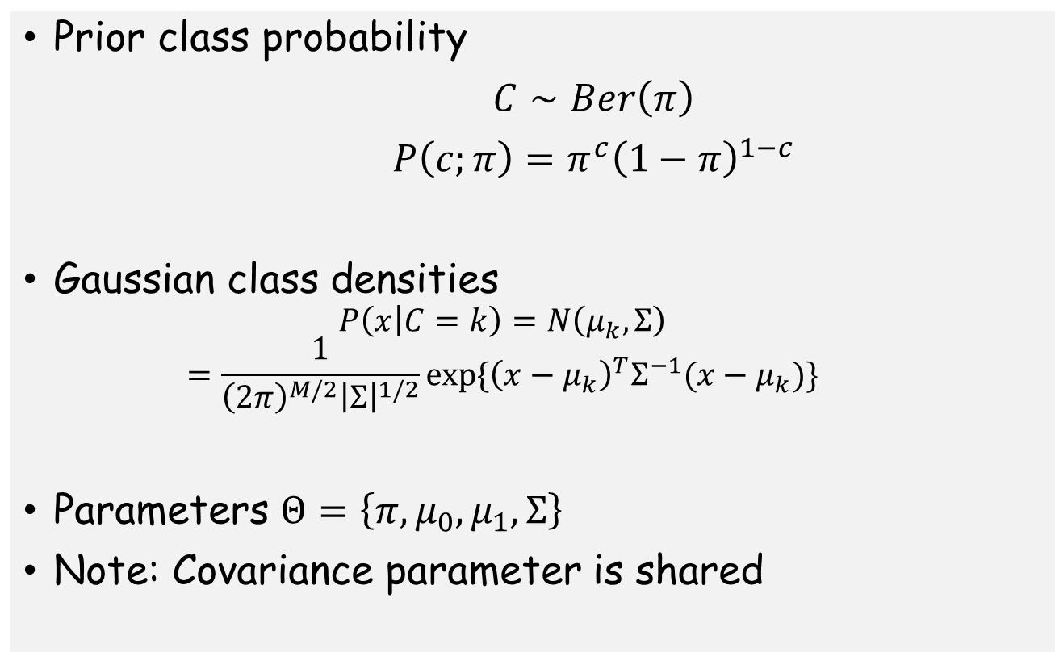
Case: Binary classification with Gaussians
Prior class probability
$C∼Ber\left(π\right)$
$P\left(c;π\right)=π^{c}{\left(1−π\right)}^{1−c}$
Gaussian class densities
$$P\left(x | C=k\right)=N\left(μ_{k},Σ\right)$$
$$=\frac{1}{{\left(2π\right)}^{M/2}{\left|Σ\right|}^{1/2}}exp⁡\{{\left(x−μ_{k}\right)}^{T}Σ^{−1}(x−μ_{k})\}$$
Parameters $Θ=\left\{π,μ_{0},μ_{1},Σ\right\}$
Note: Covariance parameter is shared

Slide 7
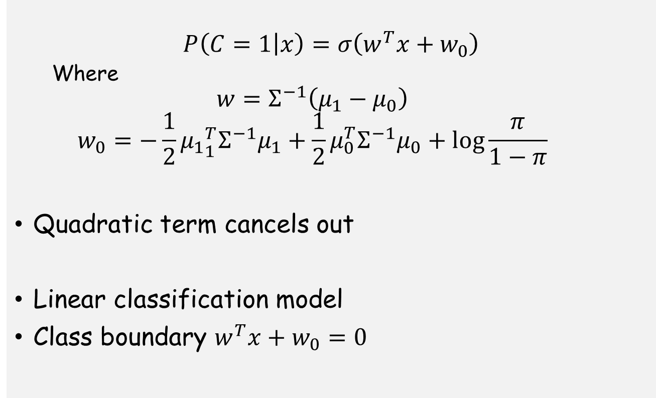
Case: Binary classification with Gaussians
$$P\left(C=1 | x\right)=σ\left(w^{T}x+w_{0}\right)$$
Where
$$w=Σ^{−1}\left(μ_{1}−μ_{0}\right)$$
$$w_{0}=−\frac{1}{2}{μ_{1}}_{1}^{T}Σ^{−1}μ_{1}+\frac{1}{2}μ_{0}^{T}Σ^{−1}μ_{0}+\log{\frac{π}{1−π}}$$
Quadratic term cancels out
Linear classification model
Class boundary $w^{T}x+w_{0}=0$

Slide 8
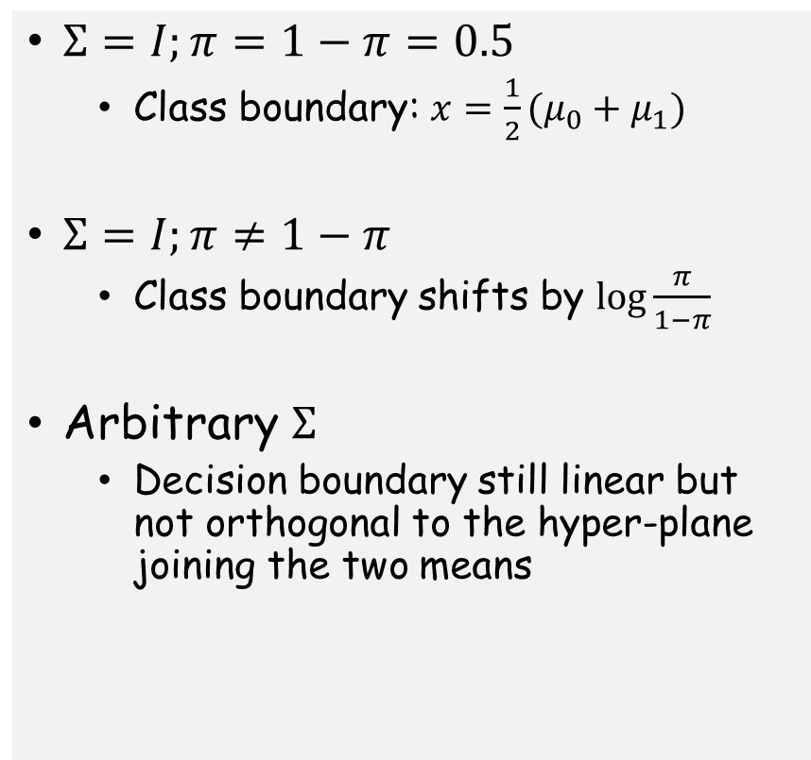
Special Cases
$Σ=I;π=1−π=0.5$
Class boundary: $x=\frac{1}{2}(μ_{0}+μ_{1})$
$Σ=I;π≠1−π$
Class boundary shifts by $\log{\frac{π}{1−π}}$
Arbitrary $Σ$
Decision boundary still linear but not orthogonal to the hyper-plane joining the two means
Image from Michael Jordan’s book

Slide 9
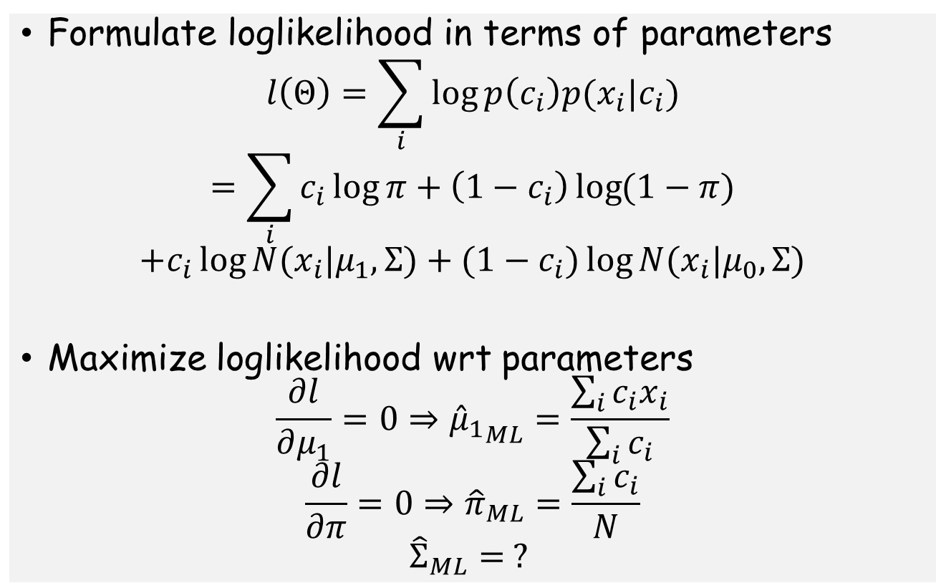
MLE for Binary Gaussian
Formulate loglikelihood in terms of parameters
$$l\left(Θ\right)=\sum_{i}{\log{p\left(c_{i}\right)p(x_{i}|c_{i})}}$$
$$=\sum_{i}{c_{i}\log{π+\left(1−c_{i}\right)\log{(1−π)}}}$$
$$+c_{i}\log{N(x_{i}|μ_{1},Σ)}+{(1−c}_{i})\log{N(x_{i}|μ_{0},Σ)}$$
Maximize loglikelihood wrt parameters
$$\frac{∂l}{∂μ_{1}}=0⇒{{\hat{μ}}_{1}}_{ML}=\frac{\sum_{i}{c_{i}x_{i}}}{\sum_{i}{c_{i}}}$$
$$\frac{∂l}{∂π}=0⇒{\hat{π}}_{ML}=\frac{\sum_{i}{c_{i}}}{N}$$
$${\hat{Σ}}_{ML}= ?$$

Slide 10
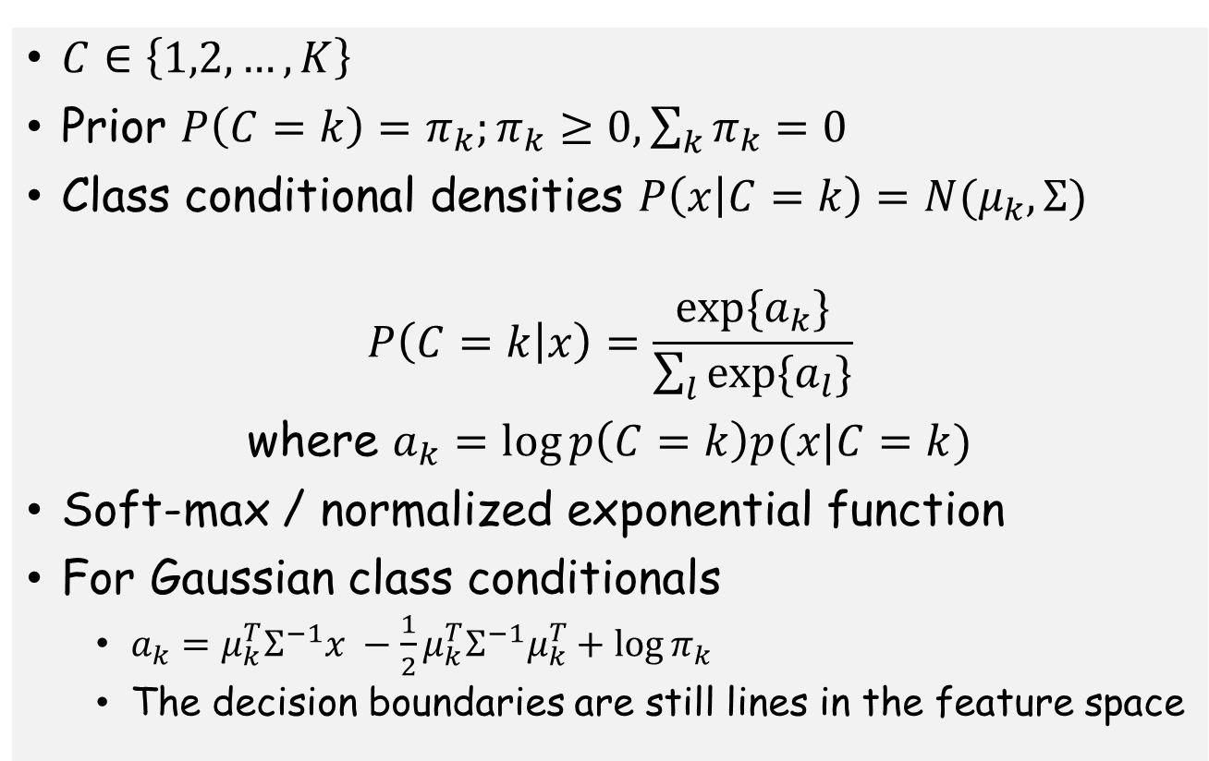
Case: Gaussian Multi-class Classification
$C∈\left\{1,2,…,K\right\}$
Prior $P\left(C=k\right)=π_{k};π_{k}≥0, \sum_{k}{π_{k}}=0$
Class conditional densities $P\left(x | C=k\right)=N(μ_{k}, Σ)$
$$P\left(C=k | x\right)=\frac{\exp{\{a_{k}\}}}{\sum_{l}{\exp{\{a_{l}\}}}}$$
where $a_{k}=\log{p\left(C=k\right)p(x|C=k)}$
Soft-max / normalized exponential function
For Gaussian class conditionals
$a_{k}=μ_{k}^{T}Σ^{−1}x −\frac{1}{2}μ_{k}^{T}Σ^{−1}μ_{k}^{T}+\log{π_{k}}$
The decision boundaries are still lines in the feature space

Slide 11
MLE for Gaussian Multi-class
Similar to the Binary case

Slide 12
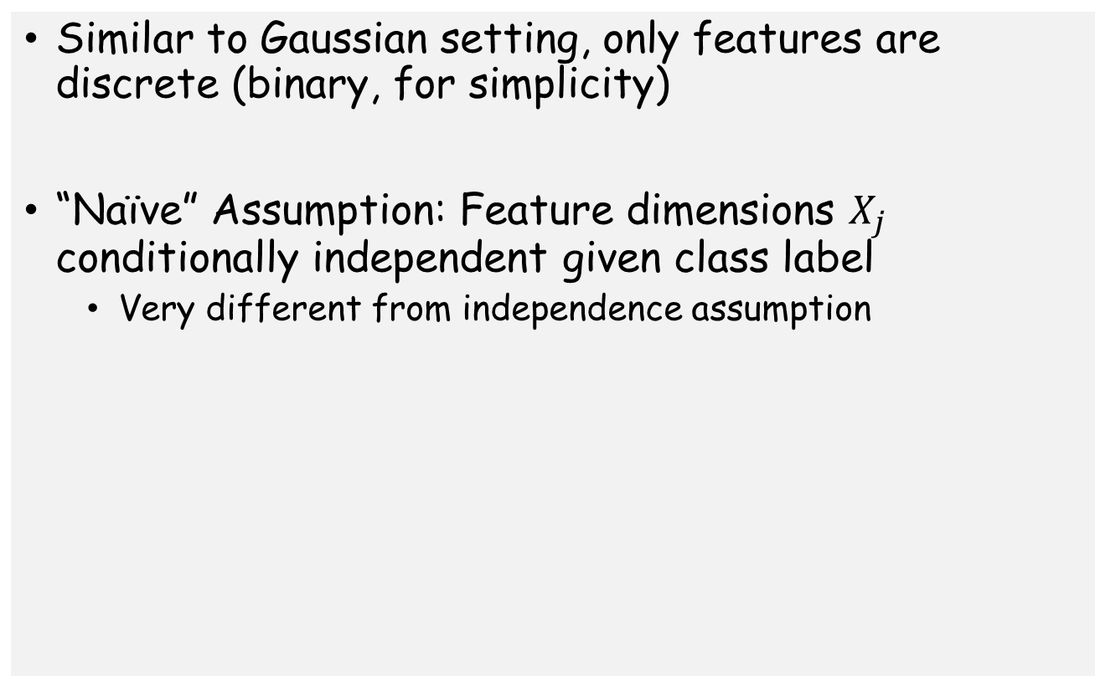
Case: Naïve Bayes
Similar to Gaussian setting, only features are discrete (binary, for simplicity)
“Naïve” Assumption: Feature dimensions $X_{j}$ conditionally independent given class label
Very different from independence assumption

Slide 13
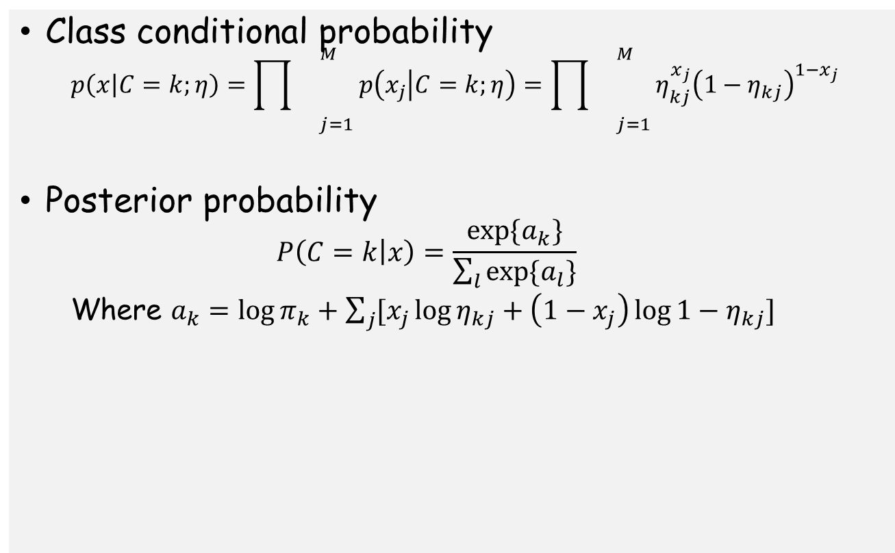
Case: Naïve Bayes
Class conditional probability
$$p\left(x | C=k;η\right)={\prod{}}_{j=1}^{M}p\left(x_{j} | C=k;η\right)={\prod{}}_{j=1}^{M}η_{kj}^{x_{j}}{\left(1−η_{kj}\right)}^{1−x_{j}}$$
Posterior probability
$$P\left(C=k | x\right)=\frac{\exp{\{a_{k}\}}}{\sum_{l}{\exp{\{a_{l}\}}}}$$
Where $a_{k}=\log{π_{k}}+\sum_{j}{[x_{j}\log{η_{kj}+\left(1−x_{j}\right)\log{1−η_{kj}]}}}$

Slide 14
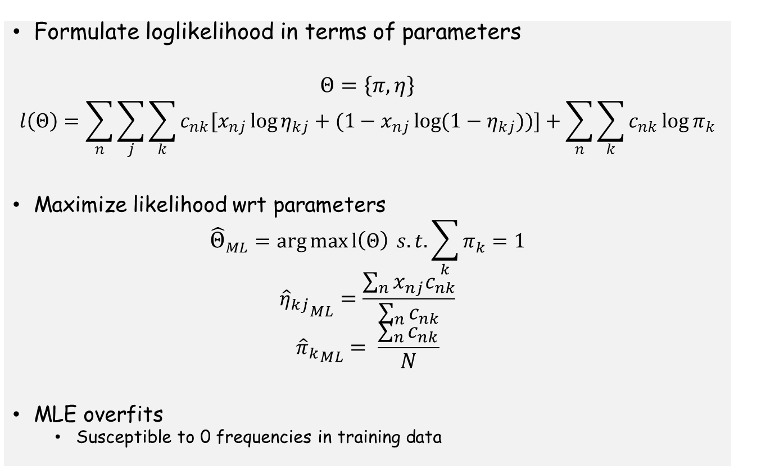
MLE for Naïve Bayes
Formulate loglikelihood in terms of parameters
$$Θ=\left\{π, η\right\}$$
$$l\left(Θ\right)=\sum_{n}{\sum_{j}{\sum_{k}{c_{nk}[x_{nj}\log{η_{kj}+(1−x_{nj}\log{(1−η_{kj})})}]}+\sum_{n}{\sum_{k}{c_{nk}\log{π_{k}}}}}}$$
Maximize likelihood wrt parameters
$${\hat{Θ}}_{ML}=\arg{\max{l\left(Θ\right) }}s.t. \sum_{k}{π_{k}=1}$$
$${{\hat{η}}_{kj}}_{ML}=\frac{\sum_{n}{x_{nj}c_{nk}}}{\sum_{n}{c_{nk}}}$$
$${{\hat{π}}_{k}}_{ML}= \frac{\sum_{n}{c_{nk}}}{N}$$
MLE overfits
Susceptible to 0 frequencies in training data

Slide 15
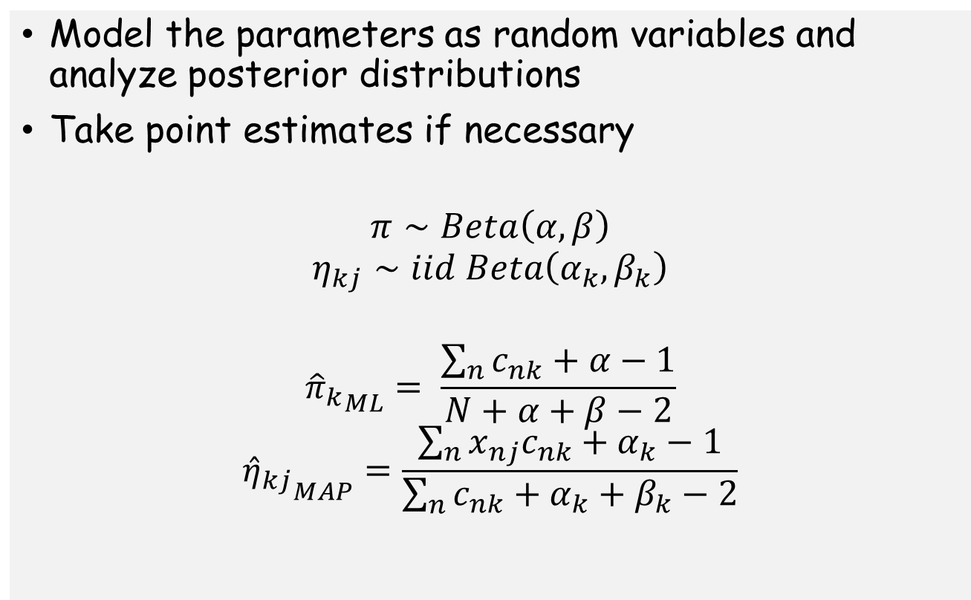
Bayesian Estimation for Naïve Bayes
Model the parameters as random variables and analyze posterior distributions
Take point estimates if necessary
$$π∼Beta\left(α,β\right)$$
$$η_{kj}∼iid Beta\left(α_{k},β_{k}\right)$$
$${{\hat{π}}_{k}}_{ML}= \frac{\sum_{n}{c_{nk}}+α−1}{N+α+β−2}$$
$${{\hat{η}}_{kj}}_{MAP}=\frac{\sum_{n}{x_{nj}c_{nk}+α_{k}−1}}{\sum_{n}{c_{nk}+α_{k}+β_{k}−2}}$$

Slide 16
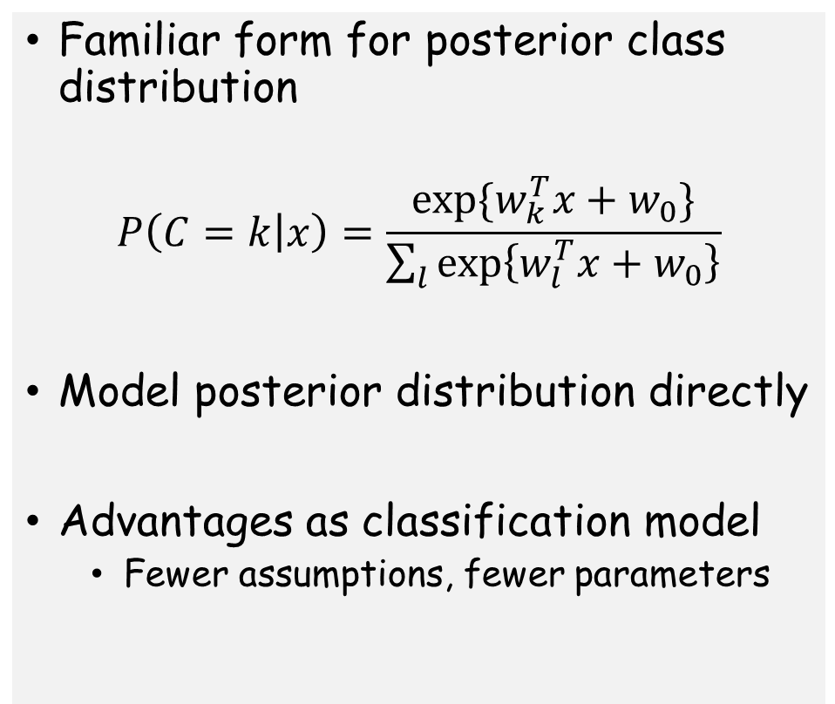
Discriminative Models for Classification
Familiar form for posterior class distribution
$$P\left(C=k | x\right)=\frac{\exp{\{w_{k}^{T}x+w_{0}\}}}{\sum_{l}{\exp\left\{w_{l}^{T}x+w_{0}\right\}}}$$
Model posterior distribution directly
Advantages as classification model
Fewer assumptions, fewer parameters
Image from Michael Jordan’s book

Slide 17
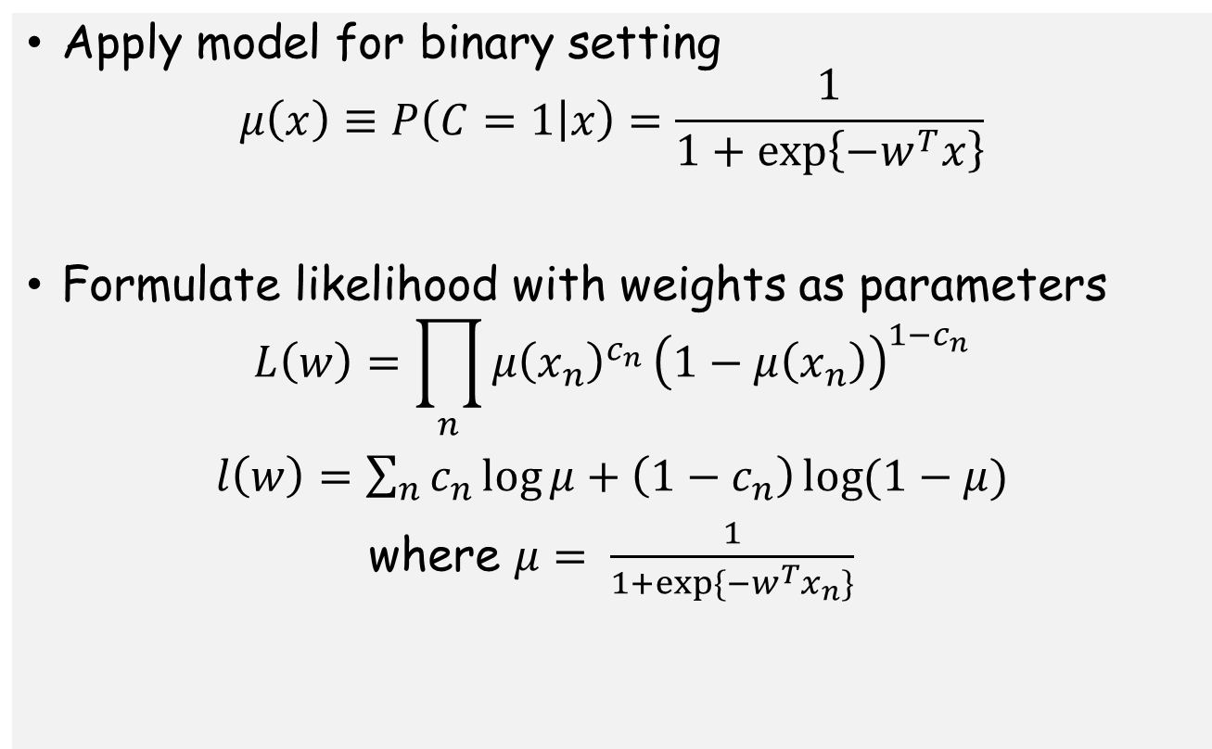
Logistic Regression for Binary Classification
Apply model for binary setting
$$μ\left(x\right)≡P\left(C=1 | x\right)=\frac{1}{1+\exp\left\{−w^{T}x\right\}}$$
Formulate likelihood with weights as parameters
$$L\left(w\right)=\prod_{n}{μ{\left(x_{n}\right)}^{c_{n}}}{\left(1−μ\left(x_{n}\right)\right)}^{1−c_{n}}$$
$l\left(w\right)=\sum_{n}{c_{n}\log{μ}+\left(1−c_{n}\right)\log{(1−μ)}}$
where $μ= \frac{1}{1+\exp{\{−w^{T}x_{n}\}}}$

Slide 18
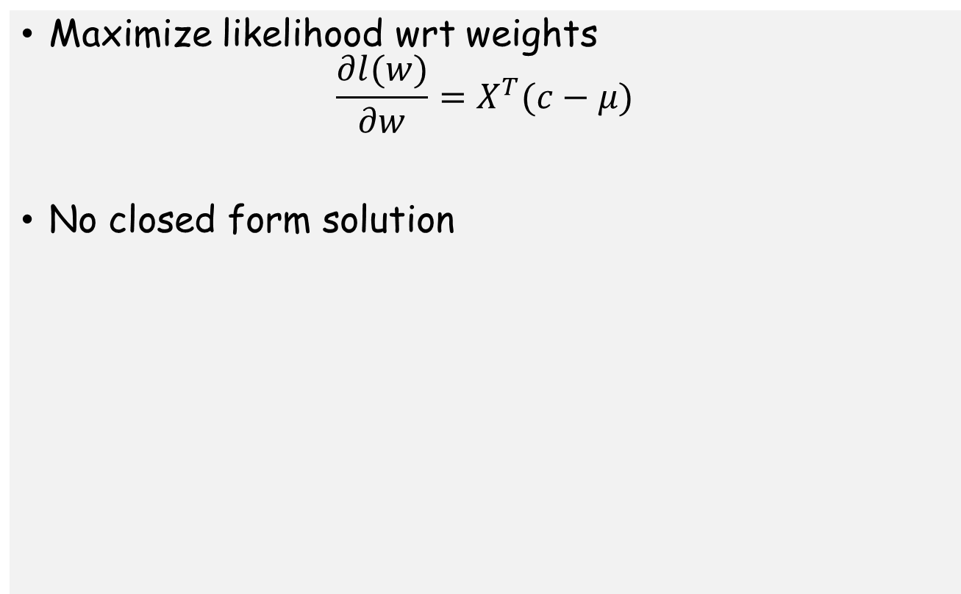
MLE for Binary Logistic Regression
Maximize likelihood wrt weights
$$\frac{∂l(w)}{∂w}=X^{T}(c−μ)$$
No closed form solution

Slide 19
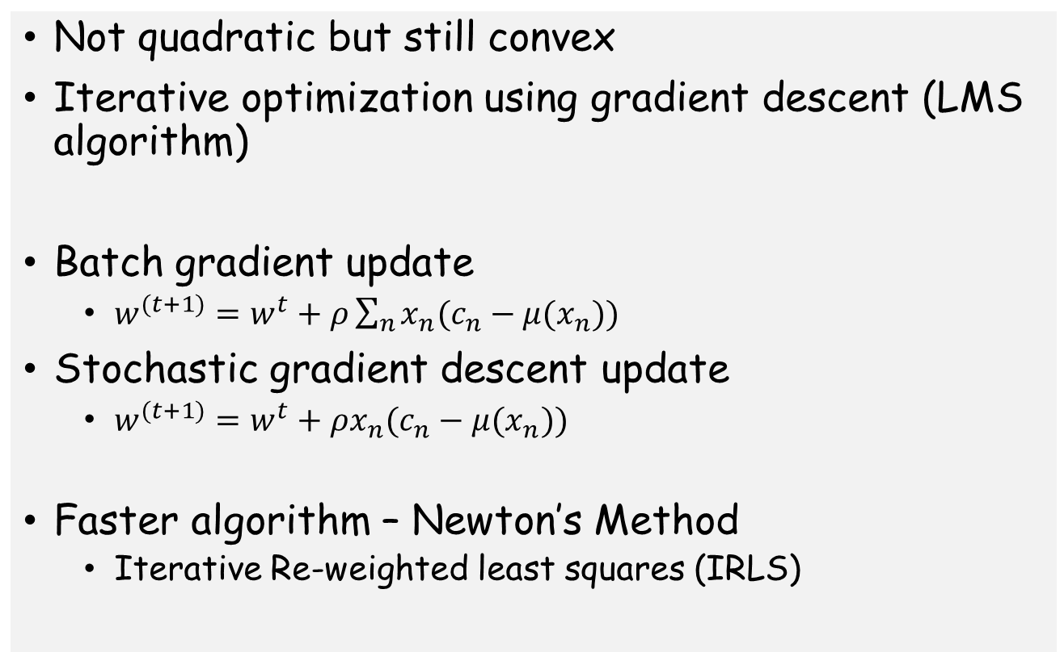
MLE for Binary Logistic Regression
Not quadratic but still convex
Iterative optimization using gradient descent (LMS algorithm)
Batch gradient update
$w^{(t+1)}=w^{t}+ρ\sum_{n}{x_{n}(c_{n}−μ(x_{n}))}$
Stochastic gradient descent update
$w^{(t+1)}=w^{t}+ρx_{n}(c_{n}−μ(x_{n}))$
Faster algorithm – Newton’s Method
Iterative Re-weighted least squares (IRLS)

Slide 20
Bayesian Binary Logistic Regression
Bayesian model exists, but intractable
Conjugacy breaks down because of the sigmoid function
Laplace approximation for the posterior
Major challenge for Bayesian framework

Slide 21
Soft-max regression for Multi-class Classification
Left as exercise

Slide 22
Choices for the activation function
Probit function: CDF of the Gaussian
Complementary log-log model: CDF of exponential

Slide 23
Generative vs Discriminative: Summary
Generative models
Easy parameter estimation
Require more parameters OR simplifying assumptions
Models and “understands” each class
Easy to accommodate unlabeled data
Poorly calibrated probabilities
Discriminative models
Complicated estimation problem
Fewer parameters and fewer assumptions
No understanding of individual classes
Difficult to accommodate unlabeled data
Better calibrated probabilities

Slide 24
Decision Theory
From posterior distributions to actions
Loss functions measure extent of error
Optimal action depends on loss function
Reject option for classification problems

Slide 25
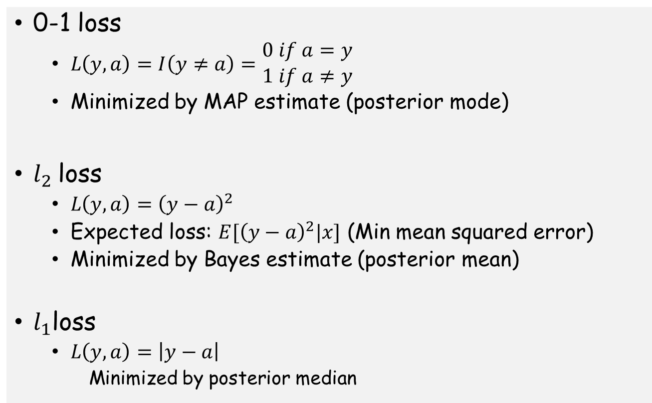
Loss functions
0-1 loss
$L\left(y,a\right)=I\left(y≠a\right)=\begin{matrix}0 if a=y \\ 1 if a≠y\end{matrix}$
Minimized by MAP estimate (posterior mode)
$l_{2}$loss
$L\left(y,a\right)={\left(y−a\right)}^{2}$
Expected loss: $E[{\left(y−a\right)}^{2}|x]$ (Min mean squared error)
Minimized by Bayes estimate (posterior mean)
$l_{1}$loss
$L\left(y,a\right)=\left|y−a\right|$
Minimized by posterior median

Slide 26
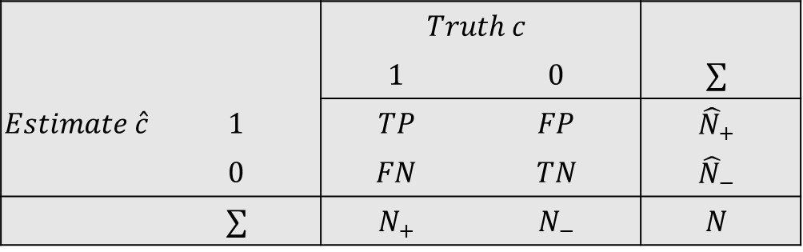
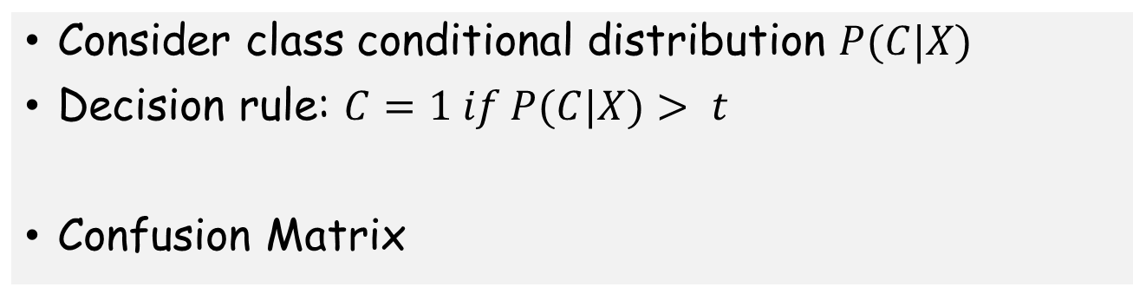
Evaluation of Binary Classification Models
Consider class conditional distribution $P(C|X)$
Decision rule: $C=1 if P(C|X)> t$
Confusion Matrix
 |  | $$Truth c$$
 |  | $$1$$ | $$0$$ | $$∑$$
$$Estimate \hat{c}$$ | $$1$$ | $$TP$$ | $$FP$$ | $${\hat{N}}_{+}$$
 | $$0$$ | $$FN$$ | $$TN$$ | $${\hat{N}}_{−}$$
 | $$∑$$ | $$N_{+}$$ | $$N_{−}$$ | $$N$$

Slide 27
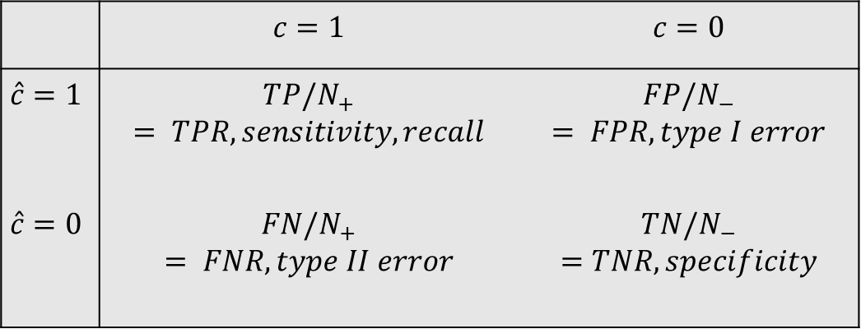
ROC curves
 | $$c=1$$ | $$c=0$$
$$\hat{c}=1$$ | $$TP/N_{+}$$ $$= TPR, sensitivity, recall$$ | $FP/N_{−}$ $$= FPR, type I error$$
$$\hat{c}=0$$ | $$FN/N_{+}$$ $$= FNR, type II error$$ | $$TN/N_{−}$$ $$=TNR, specificity$$

Slide 28
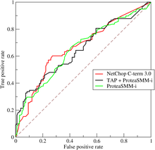
ROC curves
Plot TPR and FPR for different values of decision threshold
Quality of classifier measured by area under the curve (AUC)
Image from wikipedia

Slide 29
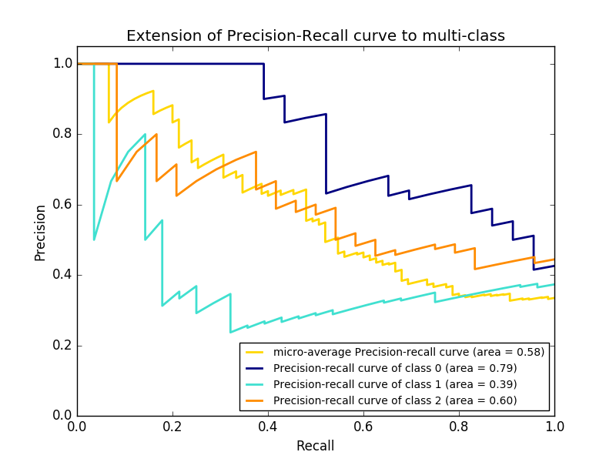
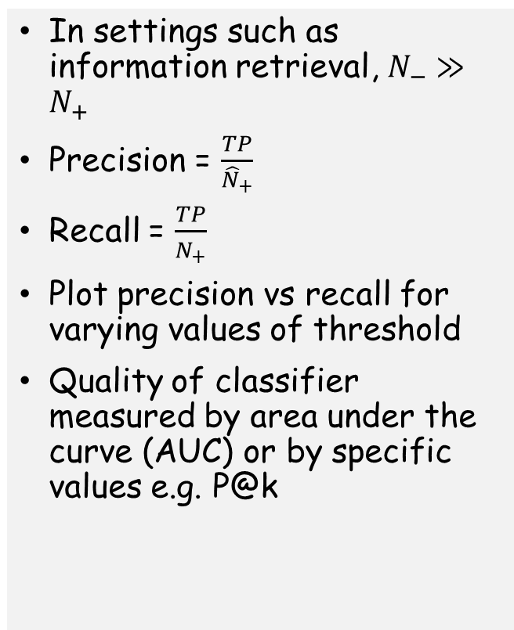
Precision-recall curves
In settings such as information retrieval, $N_{−}≫N_{+}$
Precision = $\frac{TP}{{\hat{N}}_{+}}$
Recall = $\frac{TP}{N_{+}}$
Plot precision vs recall for varying values of threshold
Quality of classifier measured by area under the curve (AUC) or by specific values e.g. P@k
Image from scikit-learn

Slide 30
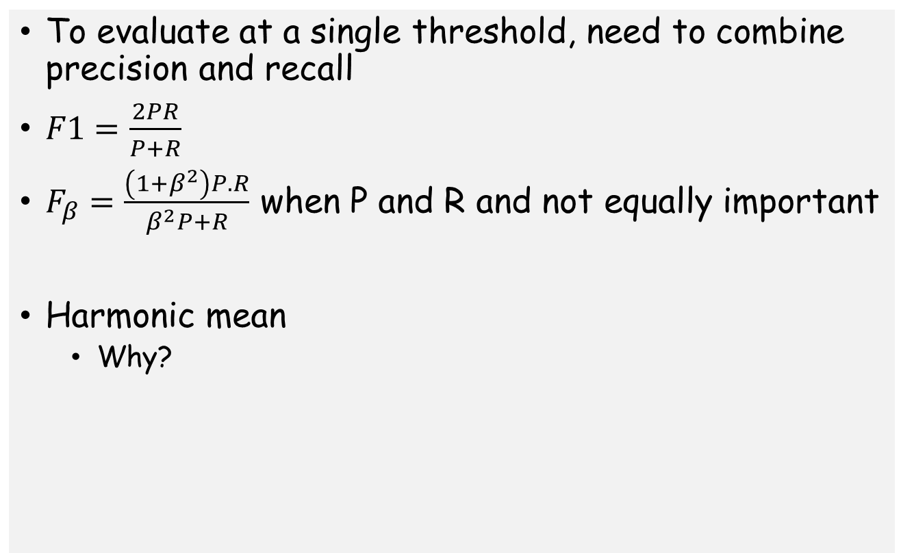
F1-scores
To evaluate at a single threshold, need to combine precision and recall
$F1=\frac{2PR}{P+R}$
$F_{β}=\frac{\left(1+β^{2}\right)P.R}{β^{2}P+R}$ when P and R and not equally important
Harmonic mean
Why?

Slide 31
Estimating generalization error
Training set performance is not a good indicator of generalization error
A more complex model overfits, a less complex one underfits
Which model do I select?
Validation set
Typically 80%, 20%
Wastes valuable labeled data
Cross validation
Split training data into K folds
For i^{th} iteration, train on K/i folds, test on i^{th} fold
Average generalization error over all folds
Leave one out cross validation: K=N

Slide 32
Summary
Generative models
Gaussian Discriminant Analysis
Naïve Bayes
Discriminative models
Logistics regression
Iterative algorithms for training
Binary vs Multiclass
Evaluation of classification models
Generalization performance
Cross validation

